Slide 1

Social Media Influence on Teen Lifestyle & Well-Being
An interactive Power BI dashboard analysing social media usage, wellness, lifestyle habits, and academic outcomes among Teens

Slide 2
Project Overview
Social media plays a significant role in teenagers' daily lives. Understanding its influence on wellness, lifestyle habits, and academic performance can help identify patterns and potential risks
Objectives
Analyse social media usage trends across teen demographics
Evaluate the impact of digital engagement on mental well-being
Assess effects on sleep, physical activity and social interactions
Examine relationships between social media habits and academic performance
Original Dataset Source – Kaggle Teen Social Media Usage & Mental Health

Slide 3
Dataset Overview
Metrics | Value
Total teens | 2500
Age Range | 13-19
Total Platforms | Instagram Tik Tok Both Other
Key Attributes | Age Gender Daily Social Media Hours Platform Usage Sleep Hours Screen Time Before Sleep Academic Performance Physical Activity Social Interaction Level Stress Level Anxiety Level Depression Label

Slide 4
Data Preprocessing
Excel- Data- Get Data- Power query Editor- Transform Data
Process | Step
Checked duplicates | Home → Keep Rows → Keep Duplicates, No duplicate entries were found
Handled missing values | View- Column Quality- Missing value analysis was performed. No null or blank values were detected
Standardized formats | Converted the First letters of column names to Capital letters In "Gender" column, Converted 'male' and 'female' to 'Male' and 'Female' In "Social_interaction_level" and "Depression_risk" columns converted 'low', 'medium' and 'high' to 'Low', ‘Medium' and 'High' Select "Academic_performance"- Transform- Rounding- To '1' decimal place Applied Clean and Trim
Corrected data types | Home → Data type, Checked and corrected all the columns data type

Slide 5
Calculated columns
Column Name | Conditions
Mental Strain Index(MSI) | Add column → Custom column → (Stress level + Anxiety level)/2
Mental Strain Status | Add column → Conditional column → “Mental Strain Index(MSI) “Less than or equal to 5- "Healthy", Less than or equal to 10- "Moderate Concern", Else- "High Risk"
Age Group | Add column → Conditional column → “Age” Less than or equal to 14- "Early Teen", Less than or equal to 18- "Mid Teen", Else- "Late Teen"
Sleep Quality | Add column → Conditional column → “Sleep hrs” Less than or equal to 6- "Poor Sleep", Less than or equal to 8.9- "Healthy Sleep", Else- "Over Sleep"
Academic Status | Add column → Conditional column → “Academic Performance” Less than or equal to 2.49- "Below Average", Less than or equal to 2.99- "Average", Less than or equal to 3.49- "Good", Else- "Excellent"
Social Media Usage Status | Add column → Conditional column → “Screen time before Sleep” Less than or equal to 1- "Low Usage", Less than 2- "Medium Usage", Else- "High Usage"
Physical Activity Status | Add column → Conditional column → “Physical Activity” Less than 1- "Poor Activity", Less than or equal to 1.5- "Moderate Activity", Else- "High Activity"
Pivot Tables
Platform wise Average Stress
Gender wise Depression Risk
Age group wise Average Social media hours
Academic Performance by Average Screen time before sleep
Mental Strain Status by Physical Activity

Slide 6
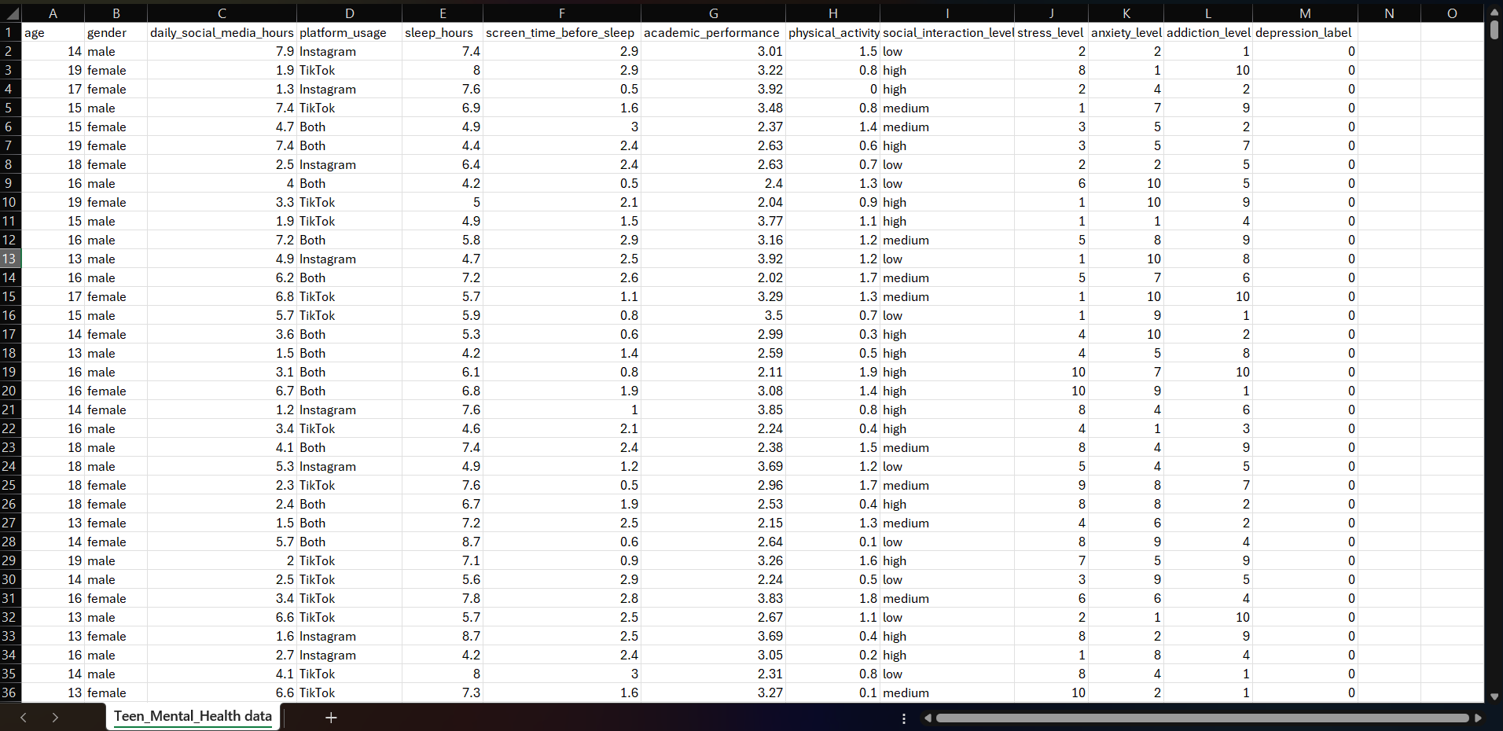
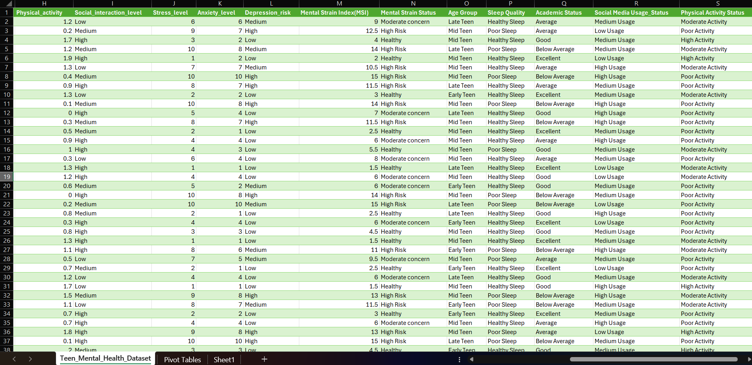
Raw Data
Cleaned Data

Slide 7
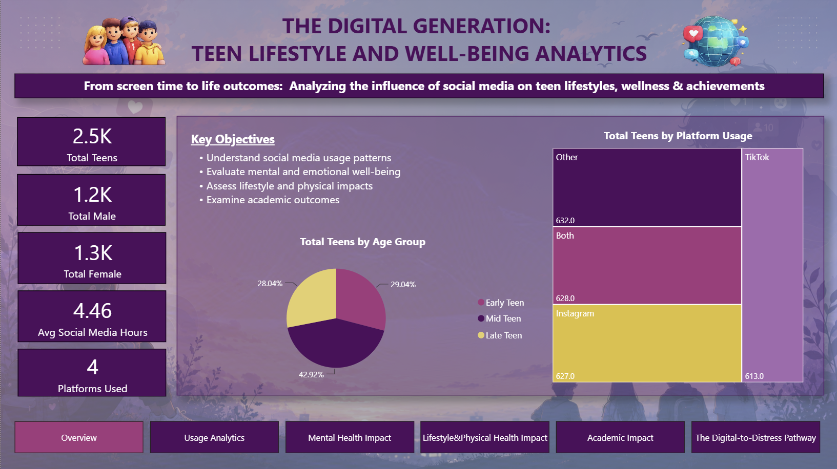
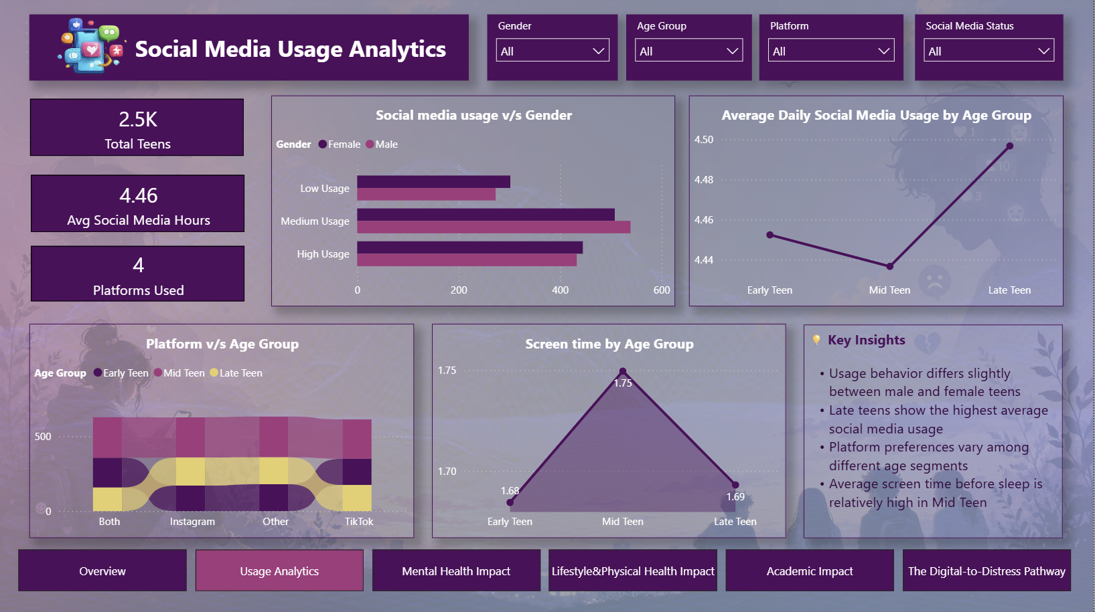
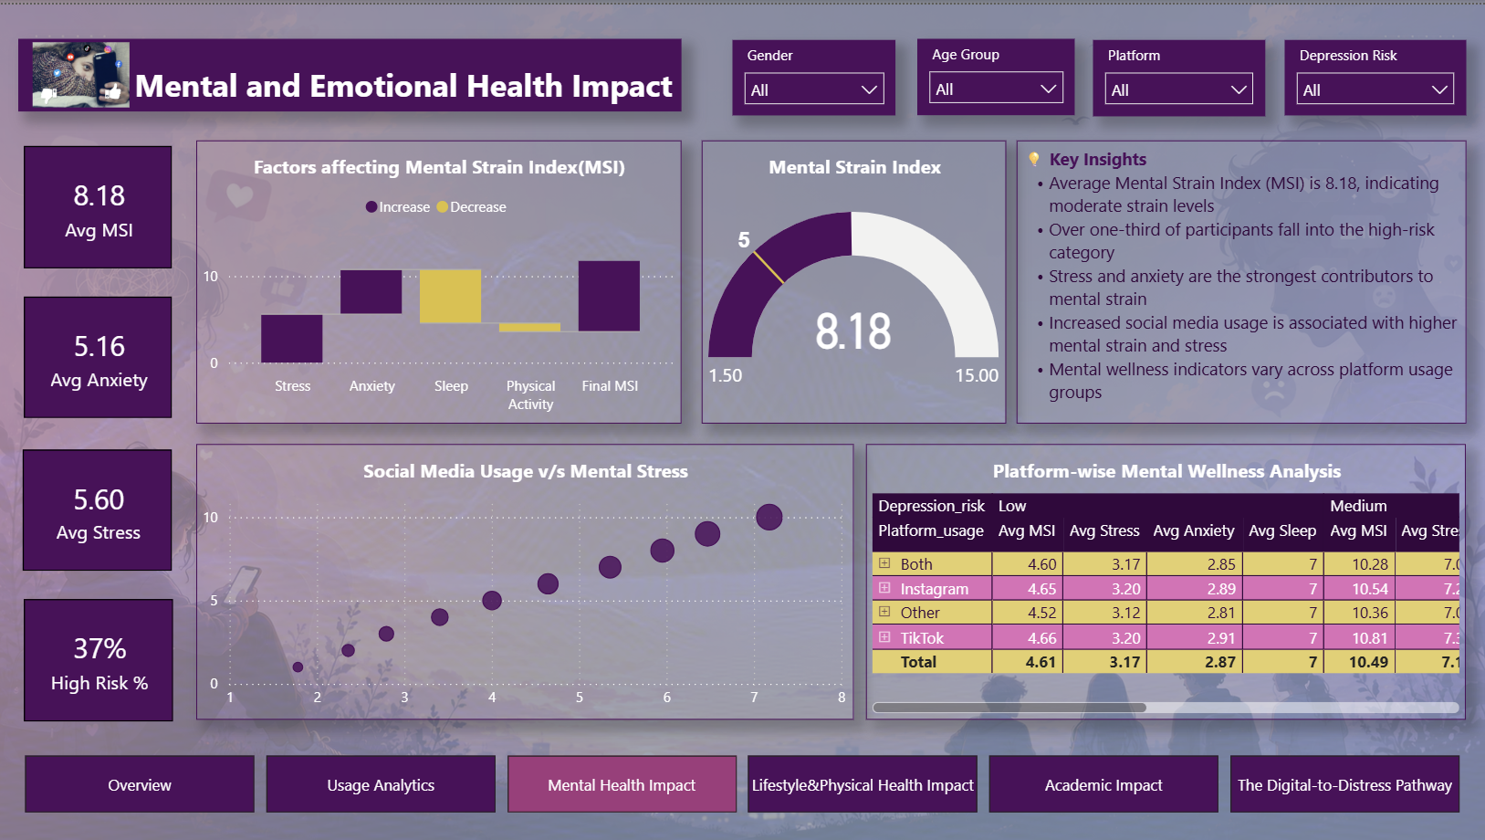
Dashboard Overview
Page 1: Overview
Page 2: Usage Analytics
Page 3: Mental Health Impact

Slide 8
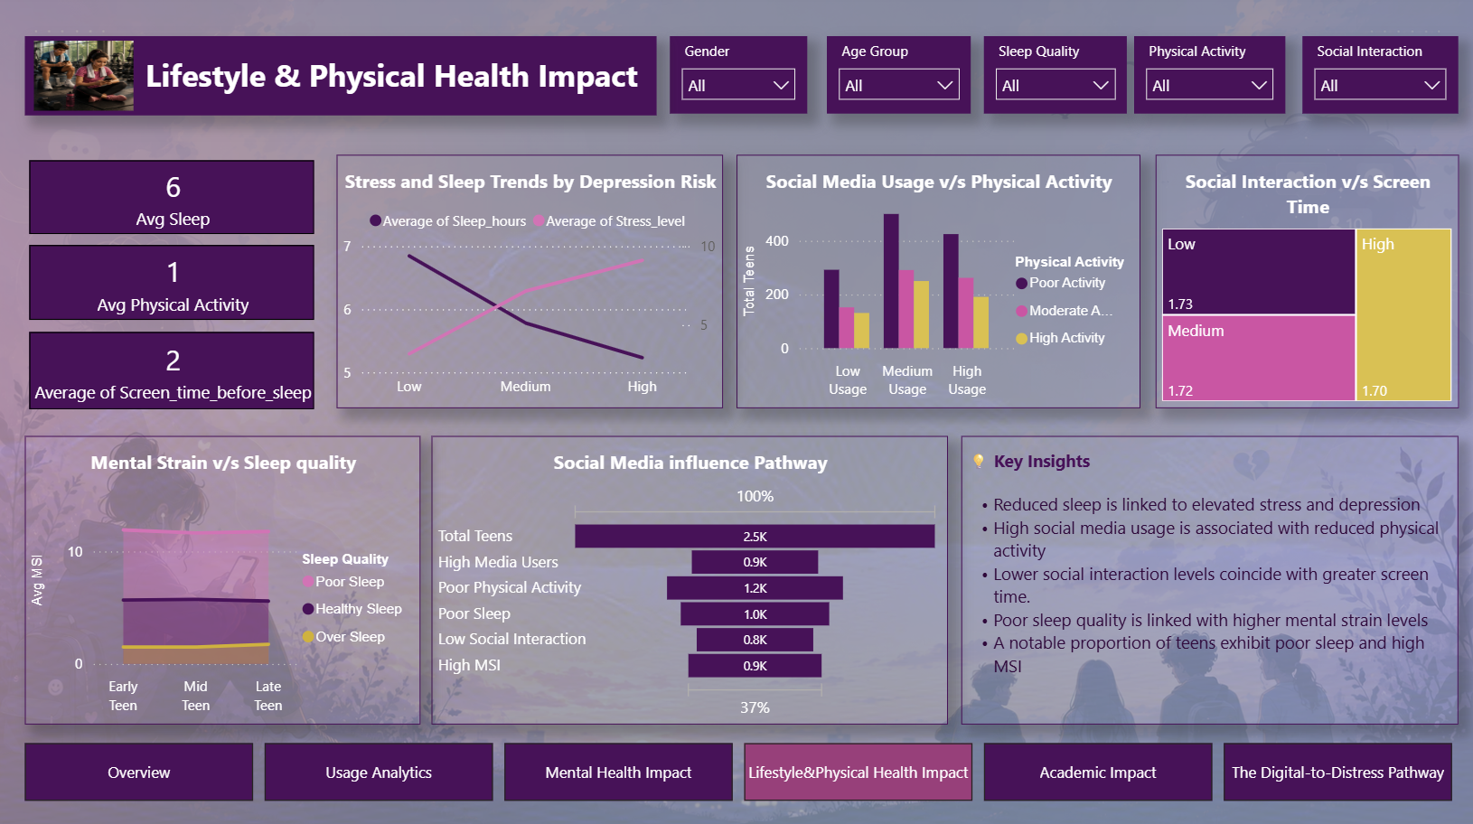
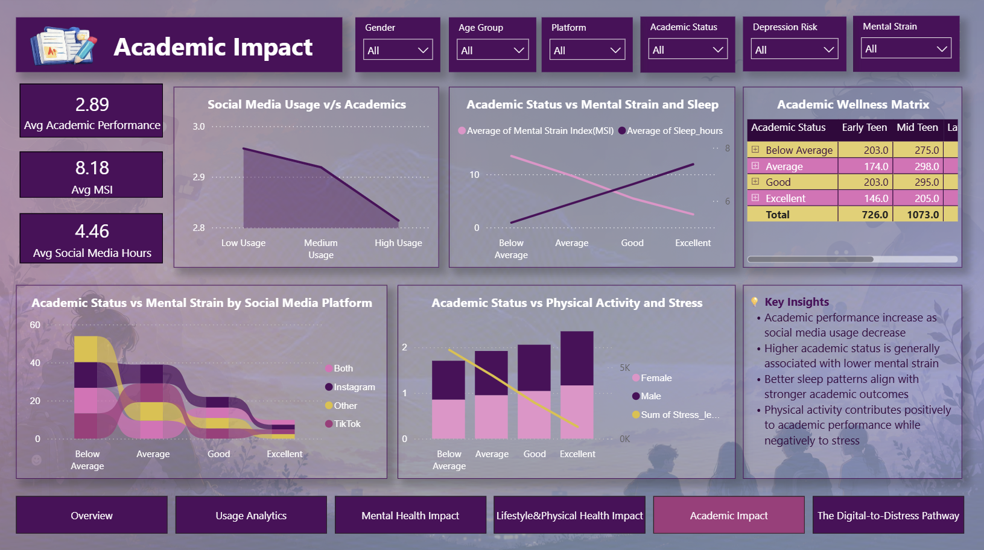
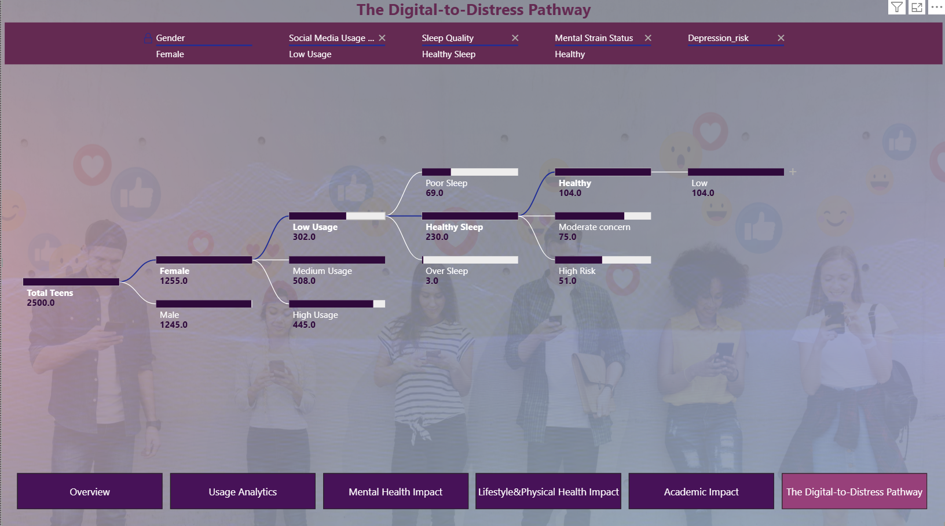
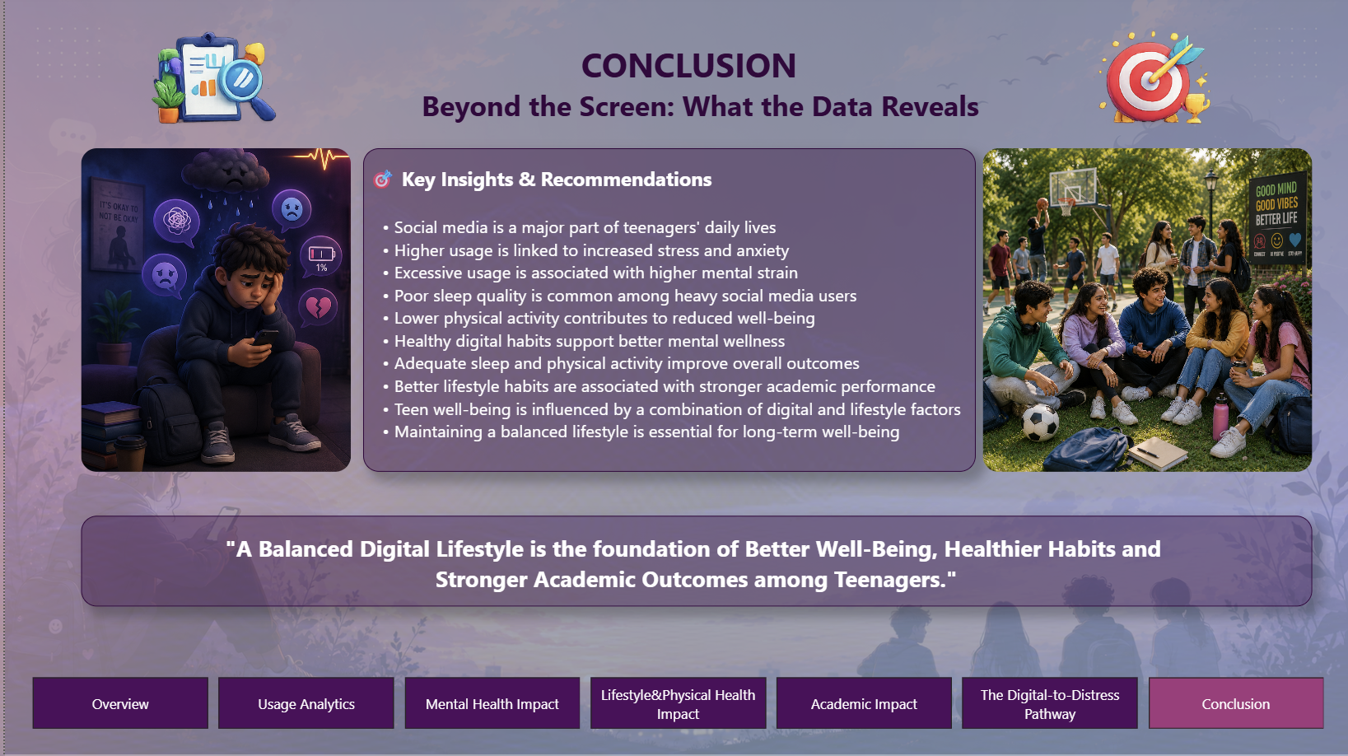
Dashboard Overview
Page 4: Lifestyle & Physical Health Impact
Page 5: Academic Impact
Page 6: The Digital-to-Distress Pathway
Page 5: Conclusion

Slide 9
Features & Tools Used
Power BI Features
Interactive multi-page dashboard design
Cards for key performance indicators
Slicers for dynamic filtering and data exploration
Page Navigation Buttons for seamless report navigation
Custom backgrounds, icons, and visual themes
Tooltips and drill-down capabilities for detailed analysis
Advanced Visualizations
Gauge Chart – Mental Strain Index (MSI) performance tracking
Waterfall Chart – Contribution of stress, anxiety, sleep, and activity to mental strain
Ribbon Chart – Ranking changes across categories
Funnel Chart – Teen Well-Being Risk Escalation analysis
Treemap – Platform and social media usage distribution
Scatter Chart – Relationship between stress and media usage
Line & Area Charts – Trend analysis
Matrix – Multi-dimensional comparison of key metrics
Decomposition Tree – Root-cause analysis of high mental strain

Slide 10
DAX Measures
Measure Name | Formula
Avg Academic Performance | AVERAGE(Teen_Mental_Health_Dataset[Academic_performance])
Avg Anxiety | AVERAGE(Teen_Mental_Health_Dataset[Anxiety_level])
Avg MSI | AVERAGE(Teen_Mental_Health_Dataset[Mental Strain Index(MSI)])
Avg Physical Activity | AVERAGE(Teen_Mental_Health_Dataset[Physical_activity])
Avg Sleep | AVERAGE(Teen_Mental_Health_Dataset[Sleep_hours])
Avg Social Media Hours | AVERAGE(Teen_Mental_Health_Dataset[Daily_social_media_hours])
Avg Stress | AVERAGE(Teen_Mental_Health_Dataset[Stress_level])
High Media Users | CALCULATE([Total Teens], Teen_Mental_Health_Dataset[Social Media Usage Status] = "High Usage")
High MSI | CALCULATE([Total Teens], Teen_Mental_Health_Dataset[Mental Strain Status] = "High Risk")
High Risk | CALCULATE([Total Teens], Teen_Mental_Health_Dataset[Mental Strain Status] = "High Risk")
High Risk % | DIVIDE([High Risk], [Total Teens])
Low Social Interaction | CALCULATE([Total Teens], Teen_Mental_Health_Dataset[Social_interaction_level] = "Low")
Low Social Interaction % | DIVIDE([Low Social Interaction], [Total Teens])

Slide 11
DAX Measures
Measure Name | Formula
Max-MSI | MAX(Teen_Mental_Health_Dataset[Mental Strain Index(MSI)])
Min-MSI | MIN(Teen_Mental_Health_Dataset[Mental Strain Index(MSI)])
Platforms Used | DISTINCTCOUNT(Teen_Mental_Health_Dataset[Platform_usage])
Poor Physical Activity | CALCULATE([Total Teens], Teen_Mental_Health_Dataset[Physical Activity Status] = "Poor Activity")
Poor Sleep | CALCULATE([Total Teens], Teen_Mental_Health_Dataset[Sleep Quality] = "Poor Sleep")
Poor Sleep % | DIVIDE([Poor Sleep], [Total Teens])
Target MSI | 5
Total Female | CALCULATE([Total Teens], Teen_Mental_Health_Dataset[Gender] = "Female")
Total Male | CALCULATE([Total Teens], Teen_Mental_Health_Dataset[Gender] = "Male")
Total Teens | COUNTROWS(Teen_Mental_Health_Dataset)
Waterfall Value | DAX SWITCH( SELECTEDVALUE(WaterfallFactors[Factor]), "Stress", [Avg Stress], "Anxiety", [Avg Anxiety], "Sleep", -[Avg Sleep], "Physical Activity", -[Avg Physical Activity], "Final MSI", [Avg MSI], BLANK() )

Slide 12
Key Conclusions
Social media has become an integral part of teenagers' daily routines, with an average usage of 4.46 hours per day
Higher social media engagement is associated with increased stress, anxiety, and overall mental strain
Poor sleep quality and reduced physical activity contribute significantly to higher mental strain levels
Teens with balanced digital habits generally demonstrate better wellness, lifestyle outcomes, and academic performance
Mental well-being is influenced by a combination of digital behaviour, sleep patterns, physical activity, and social interaction
Data-driven analysis highlights the importance of maintaining a healthy balance between online engagement and daily life activities
Recommendations
Promote Responsible Social Media Usage
Improve Sleep Hygiene
Encourage Physical Activity
Strengthen Social Connections
Support Academic Well-Being

Slide 13
THANK YOU

